Slide 1
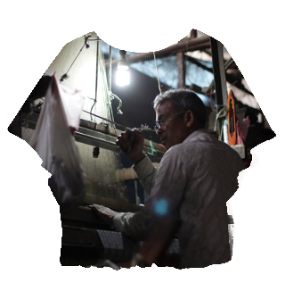
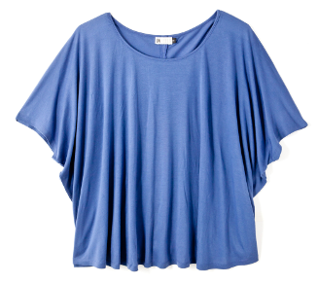
INHEELS SHOP +
SURFACED SCENES
2016/6/27-7/3 Admission Free
PARTY 7/2 18:00- 1000yen (inc. 1 drink)
@Gallery Conceal
150-0043 東京都渋谷区道玄坂1-11-3 富士商事ビル４F

Slide 2
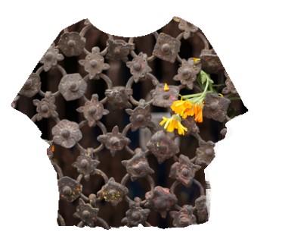
INHEELS SHOP +
SURFACED SCENES
2016/6/27-7/3 Admission Free
PARTY 7/2 18:00- 1000yen (inc. 1 drink)
@Gallery Conceal
150-0043 東京都渋谷区道玄坂1-11-3 富士商事ビル４F

Slide 3
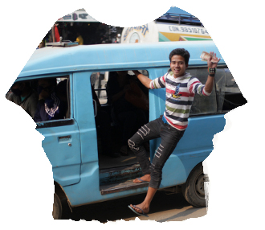
INHEELS SHOP +
SURFACED SCENES
2016/6/27-7/3 Admission Free
PARTY 7/2 18:00- 1000yen (inc. 1 drink)
@Gallery Conceal
150-0043 東京都渋谷区道玄坂1-11-3 富士商事ビル４F

Slide 4

INHEELS SHOP +
SURFACED SCENES
2016/6/27-7/3 Admission Free
PARTY 7/2 18:00- 1000yen (inc. 1 drink)
@Gallery Conceal
150-0043 東京都渋谷区道玄坂1-11-3 富士商事ビル４F

Slide 5

INHEELS SHOP +
SURFACED SCENES
2016/6/27-7/3 Admission Free
PARTY 7/2 18:00- 1000yen (inc. 1 drink)
@Gallery Conceal
150-0043 東京都渋谷区道玄坂1-11-3 富士商事ビル４F

Slide 6
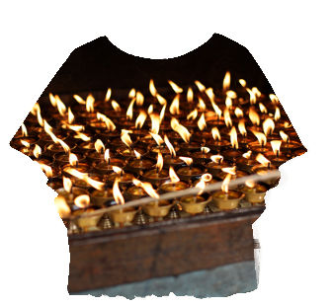
INHEELS SHOP +
SURFACED SCENES
2016/6/27-7/3 Admission Free
PARTY 7/2 18:00- 1000yen (inc. 1 drink)
@Gallery Conceal
150-0043 東京都渋谷区道玄坂1-11-3 富士商事ビル４F

Slide 7

INHEELS SHOP +
SURFACED SCENES
2016/6/27-7/3 Admission Free
PARTY 7/2 18:00- 1000yen (inc. 1 drink)
@Gallery Conceal
150-0043 東京都渋谷区道玄坂1-11-3 富士商事ビル４F

Slide 8

INHEELS SHOP +
SURFACED SCENES
2016/6/27-7/3 Admission Free
PARTY 7/2 18:00- 1000yen (inc. 1 drink)
@Gallery Conceal
150-0043 東京都渋谷区道玄坂1-11-3 富士商事ビル４F

Slide 9
INHEELS SHOP +
SURFACED SCENES
2016/6/27-7/3 Gallery Conceal

